Slide 1

OBI AQSH Open Bike Initiative Air Quality Sensor Hub
A low cost and portable sensor hub, designed to measure cyclists’ exposure to pollutants to be integrated with the Intel OBI unit.
Ali Alavi, Meng Lei, Pedro Munoz, Robert Flory
Portland State University

Slide 2

Overview
Pollutants:
Ozone
Nitrous Oxide
Sulfur Dioxide
Lead
Particulate Matter
Carbon Monoxide
Notes:
-Primary urban air pollutants as defined by the EPA are ozone, nitrous oxides, sulfur dioxide, lead, particulate matter and carbon monoxide.
-Every day, bicycle riders are exposed to these pollutants with no reliable method of evaluating their level of intake.
-We aim to provide this information to riders in order to help evaluate ideal paths of travel, best times to ride, as well as any other factors that can be used to minimize their exposure to pollutants.
-Sensors to detect the ozone, nitrous oxides, sulfur dioxide, and lead are expensive, in the hundreds of dollars.
-Our design will focus on detecting particulate matter and carbon monoxide with the possibility of adding benzene/hydrocarbon.
-In order to accomplish this, low cost metal oxide gas sensors for CO and possibly benzene and hydrocarbons, as well as environmental sensors for particulate matter will be implemented into the system.

Slide 3
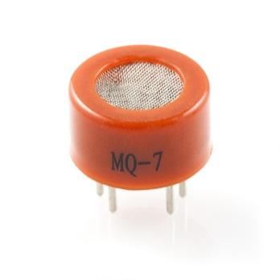
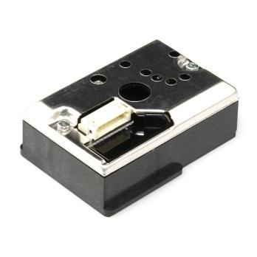
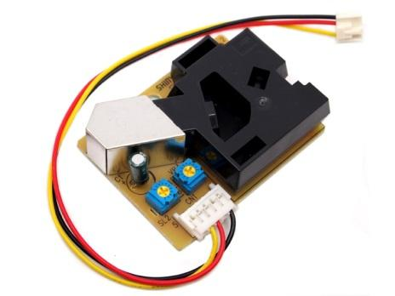
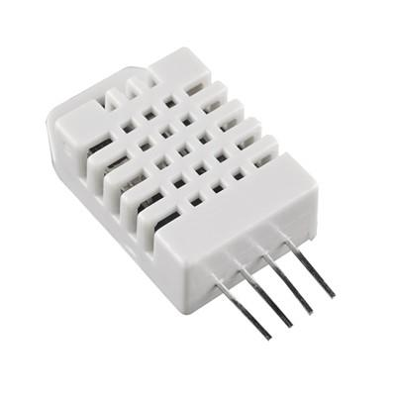
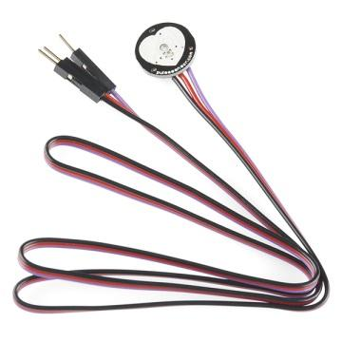
Sensors
MQ-7
(CO)
COM­-09689
(Dust)
SEN-12291P
(Dust)
SEN­-10167
(TEMP+HUMIDITY)
SEN­-11574
(Pulse)
Notes:
Each person talks about their sensors a bit.

Slide 4
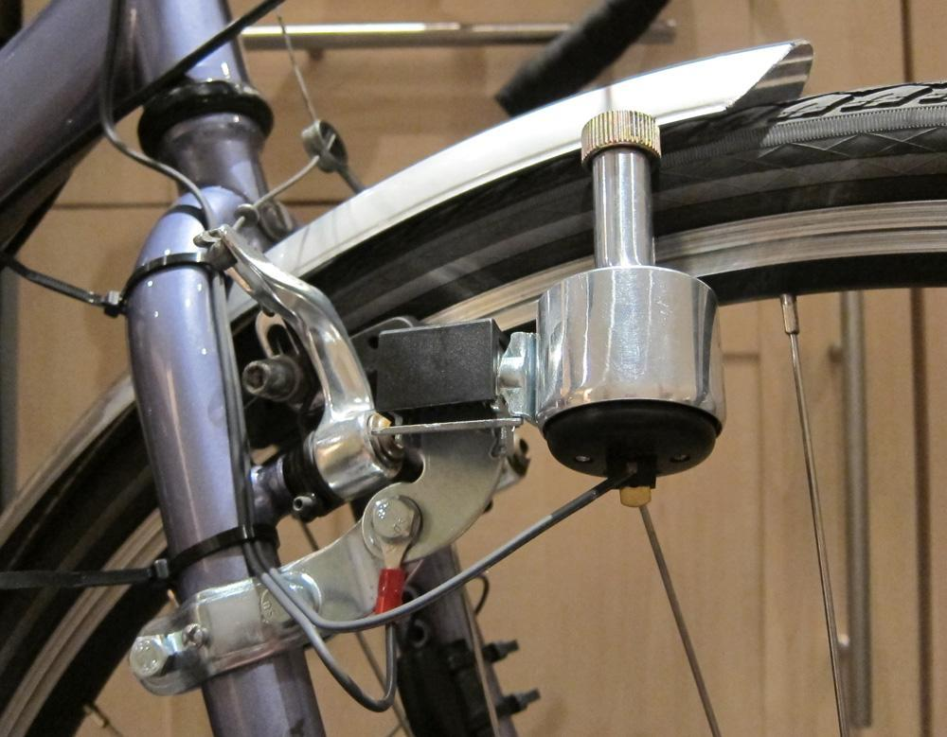
Dynamo
Notes:
2-pin terminal blocks or a 2-pin header to pass through the V_AC_x lines. This is what we would connect to the dynamo.
second 2-pin terminal block or 2-pin header for V5X_USB and GND.
water-resistant MicroUSB port.

Slide 5
Circuit Design
3.3V
5V
MQ-7 +
Regulation
2-pin AC terminal
3.3V
ATMEGA328P
RTC
Miro
USB
Vcc = 3.3V
VAC+
VAC-
V_5X_USB
GND
Cable Cut Detect
RS232_RX
RS232_TX
3.3V
Memory
RJ-45
3.3V

Slide 6
Features Summary
Collect CO, PM, temperature and humidity, and pulse records.
RS232 Tx/Rx interface with RJ-45 connection to the main box.
3.3V power on to collect data and off otherwise.
Time stamping of the data using RTC (real-time clock).
Main box will set the time in the downstream box.
Adjustable sensing rate (1 Hz down to ~0.003333 Hz).
Up to ~1000 sensor readings stored locally (in the AQSH box).
Report number of sensor records stored locally to main box.
Read and clear sensor record.
Clear all sensor records without reading.
2-pin terminal blocks or 2-pin header to pass through the V_AC_x lines.
Water-resistant MicroUSB port for power transfer to the main box.
Notes:
The system will be housed in an enclosure with openings to allow for copious airflow as required by
the sensors. The box will have an RJ45 jack to connect to the main OBI unit, as well as two 2pin
headers to pass AC power from the dynamo to the host system.
The box will communicate with the OBI system through the RS232 interface. In accordance with
sponsor specification the designed system will implement the following features:
Data collection will begin when the 3.3V power supply is turned on.
2. Up to 100 data records will be stored internally. The data will be delivered to the host
system in response to a “read record” request. After records have been delivered it will be
purged from the storage. There will be a procedure for reporting the current number of
stored records, as well as a command to clear all records.
3. The system will implement a powersupply
independent real time clock so that each record
has a timestamp. The OBI host will be able to set the realtime
clock.
4. The OBI host will be able to set the data collection rate from once per second (1 Hz) to
once every 300 seconds (3.33 mHz). Some of the sensors cannot take readings every
second. In this case the most recent record will be duplicated.
5. Arduino code for the host will be developed. This will include setting the real time clock,
reading and purging records, reporting the number of stored records and setting the sensor
rate. The sponsor will be responsible for the code that turns on the 3.3V power supply.
6. After a record has been read the host system will send the data to cloud storage. The data
will have a GPS coordinates added. The sponsor is responsible for implementing the GPS
data and cloud interface.
7. The data can be downloaded from cloud storage in a format suitable for presentation using
a spreadsheet.

Slide 7
Thank You

